Slide 1


Employee Demographics and Performance Analysis
Insights and Strategic Recommendations
IDJEDJE PRINCE COLLINS
Notes:
Welcome everyone. Today, I’ll be presenting our analysis of employee demographics and performance, along with strategic recommendations for optimizing workforce management. I’m Mena, and I’m excited to share these insights with you.

Slide 2
OBJECTIVES
Analyze
Employee Demographics
Performance
Attrition rates
Identify
Key Trends
Provide
Actionable Recommendations
To Optimize Workforce
Management
&
Issues Across Different Departments
Notes:
Our main objectives for this presentation are to analyze employee demographics, performance, and attrition rates. We aim to identify key trends and issues across various departments and provide actionable recommendations to help improve our workforce management.

Slide 3
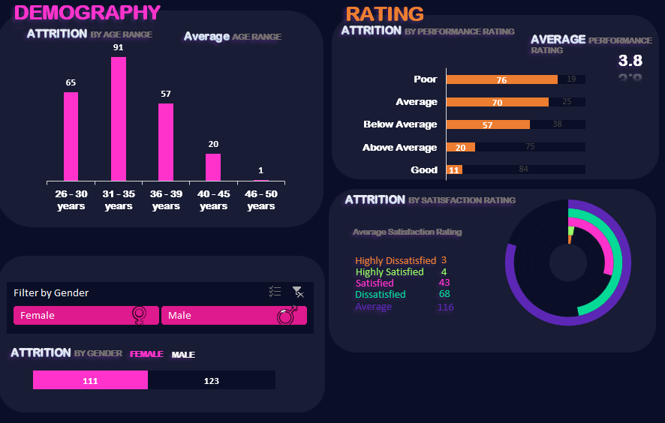
KEY FACTS
Employee Demographics:
Age distribution: Predominantly 26-35 years old.
Gender distribution: Average age 33.9, 58% male, 42% female
Performance Ratings:
Average rating: 6.8 (Below Average).
71% of employees performed below average.
Attrition Rates:
30% attrition rate overall.
Highest attrition rates in Finance (38.7%) and HR (37.1%).
Notes:
Let’s start with some key facts:
- Our employee demographics show a predominance of individuals aged 26 to 35 years.
- In terms of gender, we have a 42% female and 58% male distribution.
- Regarding performance ratings, the average rating is 6.8, which is below average, and approximately 71% of employees fall into this below-average category.
- For attrition rates, we see an overall rate of 30%, with Finance and HR departments having the highest attrition rates at around 38.7% and 37.1%, respectively.”

Slide 4
KEY INSIGHTS
1.
Departments with high attrition rates(Finance and HR) indicate potential issues with employee retention
2.
Performance ratings suggest a need for targeted improvement programs, especially in departments with lower performance levels
3.
Gender imbalance in certain departments may need addressing to ensure a balanced work environment.
Notes:
From our analysis, we can draw several key insights:
- The high attrition rates in Finance and HR suggest potential underlying issues that may be contributing to employee turnover.
- The below-average performance ratings indicate a need for focused improvement programs, particularly in departments where performance is lagging.
- There is a noticeable gender imbalance in some departments, which could impact overall workplace dynamics and effectiveness.

Slide 5
Recommendations
EMPLOYEE RETENTION
Conduct exit interviews, enhance engagement, and improve compensation packages
PERFORMANCE IMPROVEMENT
Implement training programs, regular performance reviews, and clear goal setting.
ADDRESS GENDER
IMBALANCE
Promote diversity initiatives and review hiring practices to ensure balance.
Notes:
Based on these insights, here are our recommendations:
- To address employee retention, we should conduct exit interviews to understand why employees are leaving and enhance our engagement strategies. Additionally, reviewing and possibly improving our compensation packages could help retain talent.
- For performance improvement, implementing targeted training programs and setting clear performance goals can help uplift performance levels.
- To tackle the gender imbalance, we should promote diversity initiatives and review our hiring practices to ensure a balanced and inclusive work environment.

Slide 6
Conclusion
The analysis reveals critical areas for improvement in employee performance, retention, and departmental balance.
Implementing the recommendations will help address current issues and enhance overall workforce effectiveness
Notes:
Based on these insights, here are our recommendations:
- To address employee retention, we should conduct exit interviews to understand why employees are leaving and enhance our engagement strategies. Additionally, reviewing and possibly improving our compensation packages could help retain talent.
- For performance improvement, implementing targeted training programs and setting clear performance goals can help uplift performance levels.
- To tackle the gender imbalance, we should promote diversity initiatives and review our hiring practices to ensure a balanced and inclusive work environment.

Slide 7
NEXT STEPS
ACTION
PLAN
IMPLEMENTATION TIMELINE
EXPECTED
OUTCOMES
Develop and roll out performance improvement and retention programs.
Initiate diversity and inclusion training policies.
Start development programs.
Launch engagement initiatives and diversity training.
Assess progress and adjust strategies as need.
Reduction in overall attrition rates.
Improved performance ratings across departments.
Better gender balance and employee satisfaction.
Notes:
Looking ahead, our next steps involve:
1. **Action Plan:** We will develop and implement performance improvement programs and retention strategies, and start diversity and inclusion initiatives.
2. **Implementation Timeline:** Over the next three months, we’ll begin with conducting exit interviews and performance reviews, followed by launching engagement initiatives and diversity training. We will then assess our progress and adjust strategies as needed.
3. **Expected Outcomes:** We anticipate seeing a reduction in overall attrition rates, improved performance ratings across departments, and a better gender balance, leading to higher employee satisfaction and organizational effectiveness.

